Slide 1
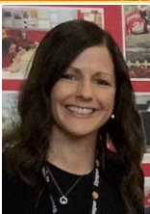
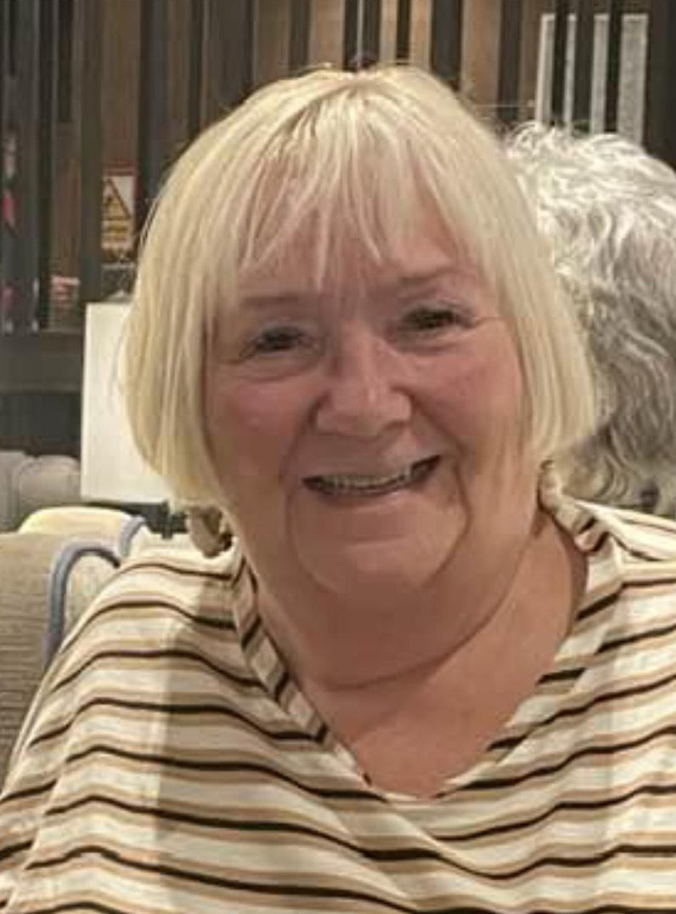
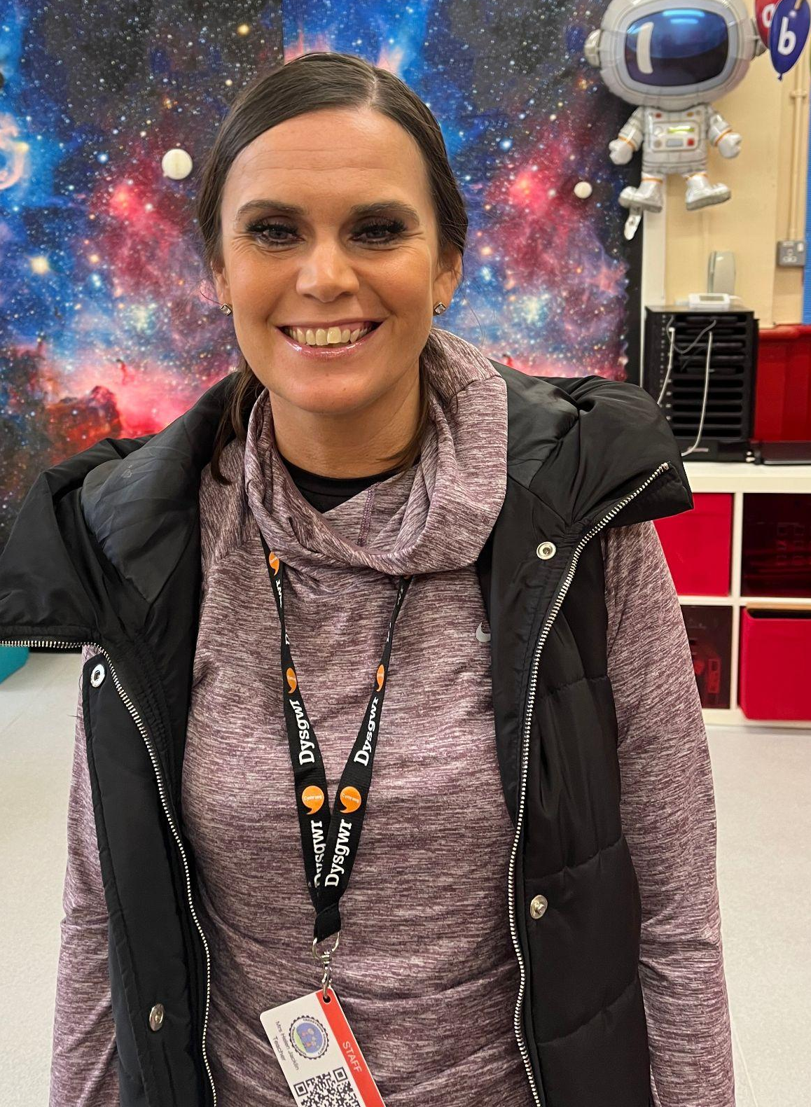
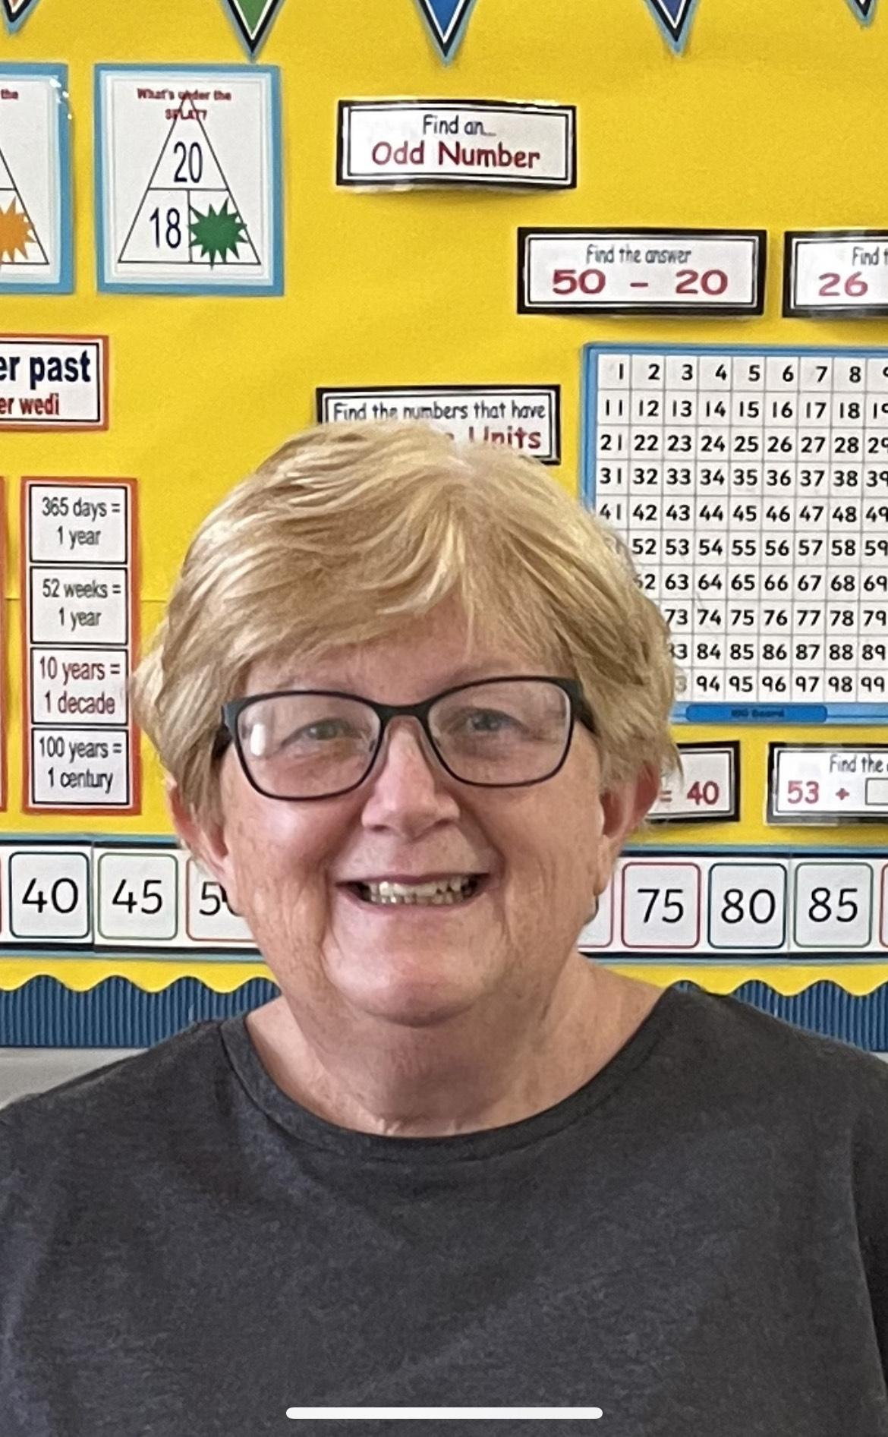

Welcome to the Troedyrhiw School Wellbeing Team
Miss Rebecca Evans.
Responsible for wellbeing.
I am also the Deputy Headteacher.
Mrs Helen Jacklin.
Responsible for wellbeing in the curriculum.
Mrs Denise Morgan.
Our wellbeing governor.

Slide 2
Cwtsh Club
It can be very distressing for parents and carers if your child is not coping well with coming into school in the mornings. Class staff will always reassure your child and find a way of providing comfort in your absence. If we think that your child may need to have some quiet one to one time to help them settle, then our Cwtsh Club leaders will come to the rescue.
How will I know if my child has settled?
Parents will have a phone call from Miss Jones our school Clerk to keep you updated.

Slide 3
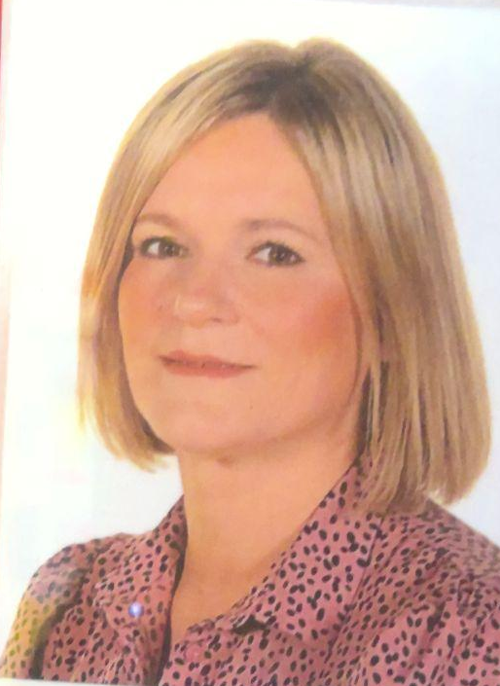
ELSA Support
ELSA stands for Emotional Literacy Support Assistant. Our school ELSA’s support the emotional needs of pupils. ELSAs are trained to plan and deliver programmes of support to pupils in our school who may be experiencing temporary or long term additional needs.
We have two trained ELSA’s currently in our school, with two more staff members being trained. They work closely with our educational psychologist. We will always ask parent permission to work with your child.
Miss Claire King
Mrs Jane Hughes
How can I get ELSA support for my child?
If you feel your child may benefit from ELSA, have a chat with your class teacher in the first instance
You may also speak to Miss Rebecca Evans Wellbeing Lead.

Slide 4
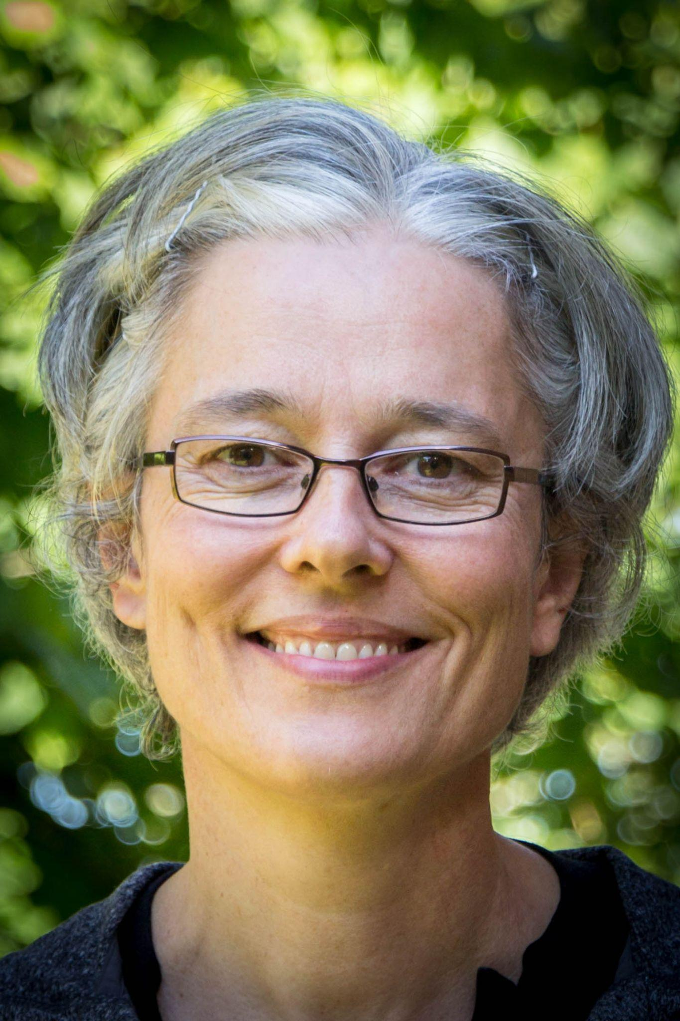
Place2Be Counsellor
Place2Be is a national charity supporting schools to improve the confidence and wellbeing of children. Place2Be provides emotional and therapeutic support to pupils and families. It gives pupils a space to express themselves through talking and creative work, and to think about any worries they might have. Place2Be also provides support for parents and staff too. Please see our school website for more detailed information.
Michelle our Place2Be counsellor is in school every Friday
What is Place2Talk?
It’s open to all pupils from Year 2 to Year 6 and they can make an appointment to spend 15 minutes with our trained counsellor, either by themselves or with a friend. Pupils often talk about friendships or any worries they may have.

Slide 5
External Agencies
Sometimes we need support and advice from other people who are not employed in our school. We generally need to make a referral to these agencies. We will ask for your consent also.
Educational Psychology Service
Our educational psychologist is Jo Thomas. The school Additional Learning Needs Coordinator (ALNCO) will make referrals to this service and parents are always fully involved in this process.
Early Help Hub
Housing, finance, Education, Health and Wellbeing, Parenting and Community Activities are some of the areas that they may be able to support families with.
If you need help please contact The Early Help Hub, Civic Centre, Castle Street, Merthyr Tydfil, Tel: 01685 725000. Alternatively please ask for Mrs Griffiths in school who can provide further information and support with the application.

Slide 6
External Agencies
Speech and Language Therapy
There are speech and language centres based at Keir Hardie Health Centre and Mountain Ash Hospital. A referral form is completed by class teacher and overseen by the ALNCO.
External Counselling
We work with ‘The Exchange’ who are a recognised counselling team for children, young people and their families. Permission is required by parents before a referral can be made.
Community Wellbeing Team
This team provide further support for our pupils that may experience some challenges with different types of behaviour.

