Slide 1

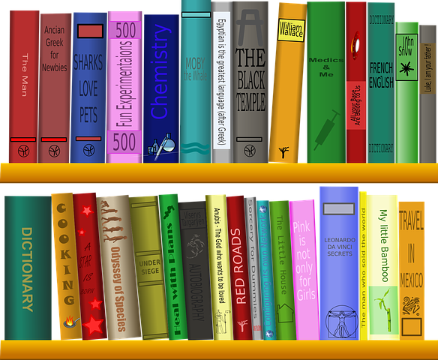
FP Reading Vipers
Improving key
reading skills

Slide 2
Reading Vipers
Vocabulary
Infer
Predict
Explain
Retrieve
Sequence

Slide 3
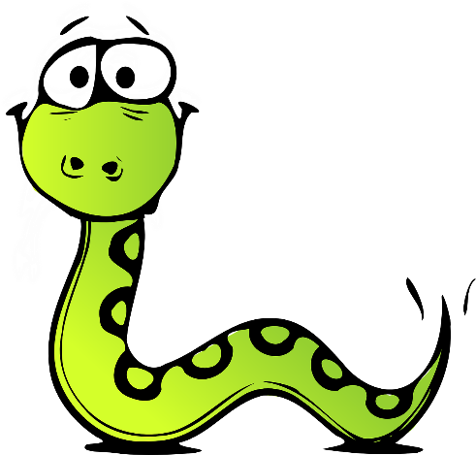
FP Reading Vipers
Vocabulary
Vocabulary
Draw upon knowledge of vocabulary in order to understand the text.
Example questions
What does the word ………. mean in this sentence?
Find and copy a word which means ……….
What does this word or phrase tell you about ………?
Which word in this section do you think is the most important? Why?
Which of the words best describes the character/setting/mood etc?
Can you think of any other words the author could have used to describe this?
Why do you think ………. is repeated in this section?

Slide 4
FP Reading Vipers
Infer
Make inferences from the text.
Example questions
Why was……. feeling……..?
Why did ………… happen?
Why did ………. say ……….?
Can you explain why……….?
What do you think the author intended when they said……….?
How does ………. make you feel?

Slide 5
FP Reading Vipers
Predict
Predict what you think will happen based on the information that you have been given.
Example questions
Look at the book cover/blurb – what do you think this book will be about?
What do you think will happen next? What makes you think this?
How does the choice of character or setting affect what will happen next?
What is happening? What do you think happened before? What do you think will happen after?
What do you think the last paragraph suggests will happen next?

Slide 6
FP Reading Vipers
Explain
Explain your preferences, thoughts and opinions about the text.
Example questions
Who is your favourite character? Why?
Why do you think all the main characters are girls in this book?
Would you like to live in this setting? Why/why not?
Is there anything you would change about this story?
Do you like this text? What do you like about it?

Slide 7
FP Reading Vipers
Retrieve
Identify and explain the key features of fiction and non-fiction texts such as: characters, events, titles and information.
Example questions
What kind of text is this?
Who did…..?
Where did…..?
When did…..?
What happened when…..?
Why did …….. happen?
How did …….?
How many…..?
What happened to……?

Slide 8
FP Reading Vipers
Sequence
Sequence the key events in the story.
Example questions
Can you number these events 1-5 in the order that they happened?
What happened after …….?
What was the first thing that happened in the story?
Can you summarise in a sentence the opening/middle/end of the story?
In what order do these chapter headings come in the story?

